Slide 1

Database Systems: Design, Implementation, and Management
Chapter 6
Normalization of Database Tables

Slide 2
Database Tables and Normalization
Normalization
Process for evaluating and correcting entity (implemented as tables in the Internal model) structures to ensure that attributes are assigned to the correct entities.
Works through a series of stages called normal forms:
First normal form (1NF)
Second normal form (2NF)
Third normal form (3NF)

Slide 3
Context – Where are we and where are we going from here within the overall process of Relational Database Design
We have studied the business rules and have derived Entities and their relationships.
We are heading towards designing our database structures (tables, indexes and constraints) from our derived entities, attributes and their relationships
Now we need to examine these entities and their attributes to establish whether we have the most efficient set of entities or whether they be reworked into a revised set that will yield a more efficient organization
To do this we will apply the technique of Normalization to our existing entities. We will ask certain questions to establish whether we can improve on what we have.
Once we have a Normalized set of entities:
The entities will be represented by our tables in our actual database.
The attributes will become columns in the respective tables.
The PKs and FKs will implemented by indexes on the respective tables and will set up the Integrity (constraint) rules between attributes from related tables.
Mandatory attribute values will be implemented by ‘NOT NULL’ constraints.
(Exam: Process of moving from Business Rules to Database Implementation)

Slide 4
Database Tables and Normalization (continued)
Normalization (continued)
2NF is better than 1NF; 3NF is better than 2NF
For most business database design purposes, 3NF is as far as we need to go.
Highest level of normalization are possible but may not be desirable

Slide 5
The Objective of the Normalization Process is to achieve a state where:
Each table represents a single subject (Entity)
No data item will be unnecessarily stored in more than one table
All attributes in a table are dependent on the primary key
Each table void of insertion, update, deletion anomalies
All tables in at least 3NF

Slide 6
Note:
Normalization works with one relation at a time
Progressively breaks table into new set of relations (or entities) based on identified dependencies

Slide 7
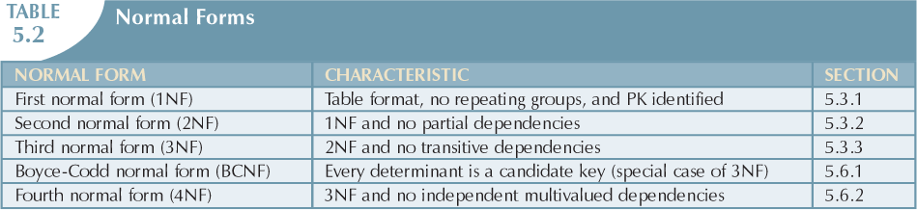

Slide 8
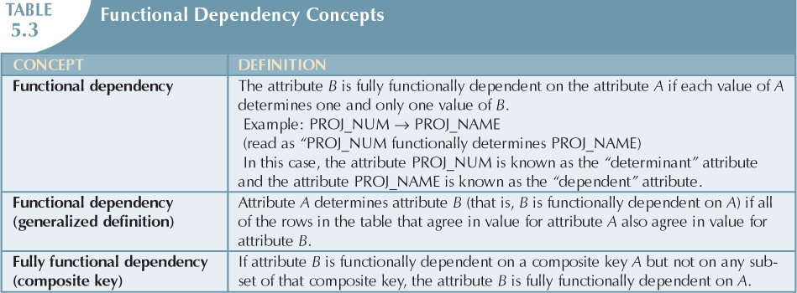

Slide 9
Conversion to First Normal Form
Step 1: Eliminate the Repeating Groups
Eliminate nulls: each repeating group attribute contains an appropriate data value
Step 2: Identify the Primary Key
Must uniquely identify the attribute’s value
New key must be composed, where necessary
Step 3: Identify All Dependencies
Dependencies depicted with a diagram

Slide 10
Repeating Groups Example
Consider a table with 6 columns (see diagram below):
Project Number, Project Name, Employee 1 details, Employee 2 details, Employee 3 details, Employee 4 details
(assume each employee details column is actually several columns – number, name, pay rate and so on..)
Total: 6 columns 4 of which are reserved for employees working on the project.
If there were only 2 employees on this project the other two columns would contain null values. A direct result of repeating groups.
This structure demonstrates repeating groups of attributes – employee details is repeated for each employee working on each project.
It is definitely not in 1NF
Project_Num
Project_Name
Emp1_Dets
Emp2_Dets
Emp3_Dets
Emp4_Dets

Slide 11
Demonstrating Repeating Groups
PROJ_NUM | EMP_NUM_1 | E1_HOURS | EMP_NUM_2 | E2_HOURS | EMP_NUM_3 | E3_HOURS
15 | 103 | 23.8 | 102 | 19.4 | 105 | 35.7
30 | 121 | 16.5 | 122 | 30.5
33 | 131 | 12.7 | 133 | 23.6
35 | 142 | 90.5
The above only shows a few key attributes for demonstrating what a repeating group is – in this case a repeating group of employee numbers and hours worked on project.
This may be OK if there were always 3 employees on each project
If there were more we would have a problem
If there were less then we would have a lot of NULL entries

Slide 12
Removing repeating groups
To remove the repeating groups we introduce new rows (entity occurrences) for each employee on each project.
The figure in the next slide, demonstrates this, with the additional details for project and employees filled in.

Slide 13
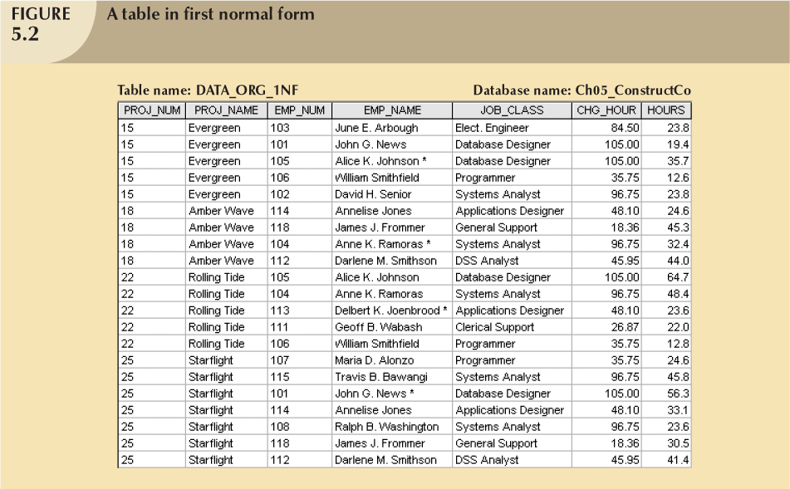
Moving towards 1 NF - Step 1: Remove repeating groups.
There are still problems with this table but at least:
There are No Null Values in this table which result from repeating groups -
Employee Attributes are not repeated as columns

Slide 14
NF1 Step 2 – Identify the Primary Key
Project Number does not uniquely identify the rest of the attributes. There are many duplicates.
We need to identify a COMPOSITE PRIMARY key:
PROJ_NUM+EMP_NUM should do it
With this combination we can uniquely identify
the remaining attributes: Project Name, Employee Name, Job Classification, Hourly rate and Hours worked on the Project.
We may still have intuitive reservations, but we will go step by step

Slide 15
Conversion to First Normal Form (Step 3)
Draw a Dependency diagram
Depicts all dependencies found within given table structure
Helpful in getting bird’s-eye view of all relationships among table’s attributes
Makes it less likely that you will overlook an important dependency

Slide 16
DEPENDENCY DIAGRAM
Partial Dependency: Proj_Name is only dependent on the Proj_Num element of the Composite PK
Transitivel Dependency: Chrg_Hour is dependent on Job_class (both of these are non-key elements)
Proj_Num
Emp_Num
Proj_Name
Emp_Name
Job_Class
Chrg_Hour
Hours
Partial Dependency:
Emp_Name and Job _Class are only dependent on the Emp_Num element of the Composite PK
Only Hours is dependent on the combination of both elements of the Composite PK – Full dependency on entire PK
1NF (Proj_Num,Emp_Num,Proj_Name,Emp_Name,Job_Class,Chrg_Hour,Hours)
Partial Dependencies :
Proj_Num Proj_name
Emp_Num Emp_Name,Job_Class,Chrg_Hour
Transitive Dependency:
Job_Class Chrg_Hour

Slide 17
Partial Dependency – A non key attribute is only
dependent on part of the primary key
– Employee Name is only dependent on Employee Number.
Transitive dependency - A a non key attribute is
dependent on another non key attribute
– Hourly charge is dependent on Job Class

Slide 18
Conversion to First Normal Form (continued)
First normal form describes tabular format in which:
All key attributes are defined
There are no repeating groups in the table
All attributes are dependent on all or part of the primary key.
Note: Table may still contain dependencies

Slide 19
Conversion to Second Normal Form
Step 1: Write Each Key Component on a Separate Line
Each component will become key in new entity (table)
Step 2: Assign Corresponding Dependent Attributes
Determine attributes that are dependent on the key attribute(s)
Step 3: Identify transitive dependencies where present

Slide 20
Conversion to 2 NF (continued)
Table is in second normal form (2NF) when:
It is in 1NF and
It includes no partial dependencies:
No attribute is dependent on only portion of primary key
(Transitive dependencies may exist)
Re-draw the dependency diagram

Slide 21
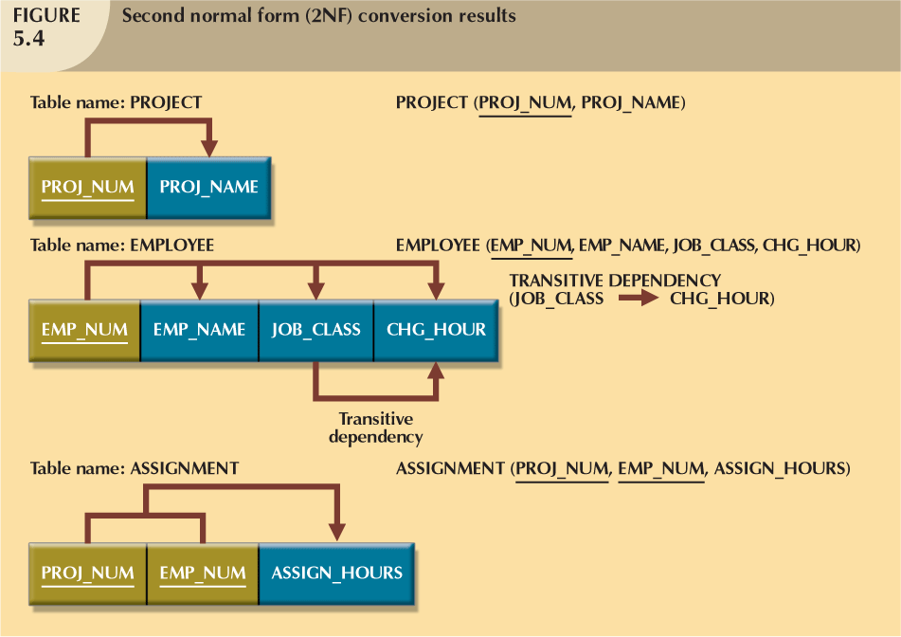
Results when steps on previous slide are carried out
The Assignment hours (originally referred as just hours)
is only related to the combination of Proj_Num and Emp_Num

Slide 22
Conversion to 3NF
Step 1:
For every transitive dependency, write its determinant as PK for new table and name the table to reflect its contents and function
Step 2:
Identify attributes dependent on each determinant identified in Step 1, rename the attribute if it makes sense to do so

Slide 23
Conversion to 3NF (continued)
Step 3:
Eliminate all dependent attributes in transitive relationship(s) from each of the tables
Draw new dependency diagram to show all tables defined in Steps 1–3
Check new tables as well as tables modified in Step 3
Each table has determinant
No table contains inappropriate dependencies

Slide 24
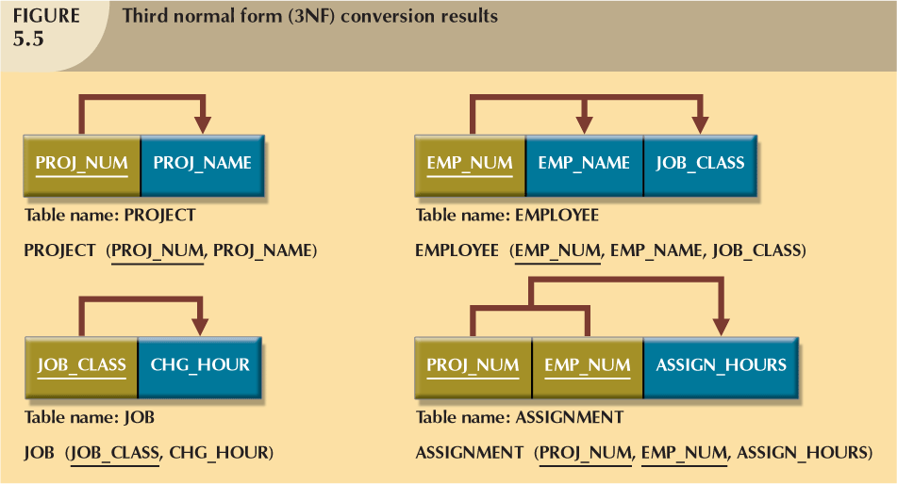
We now have 4 tables (or entities) from the original 1 Entity
and we have achieved 3NF. Primary Keys are shown underlined.
There are no partial or transitive dependencies.

Slide 25
Relational Schema. This is written in this manner: PROJECT (PROJ_NUM, PROJ_NAME) EMPLOYEE (EMP_NUM, EMP_NAME,JOB_CLASS)

Slide 26
Conversion to 3NF (continued)
A table is in third normal form (3NF) when both of the following are true:
It is in 2NF
It contains no transitive dependencies

Slide 27
Improving the Design
Normalization enables Table structures to be cleaned up so that we can eliminate initial partial and transitive dependencies
Normalization is a crucial part of the design process - It is valuable because its use helps eliminate data redundancies by ensuring attributes are attached to appropriate entities

Slide 28
Improving the Design (continued)
Issues to address in order to produce a good normalized set of tables:
Evaluate PK Assignments
Evaluate Naming Conventions
Refine Attribute Atomicity- reduce to smallest component part (e.g. address as separate attributes)
Identify New Attributes, as necessary
Identify New Relationships, as necessary
Refine Primary Keys as Required
Maintain Historical Accuracy with client’s usage

Slide 29
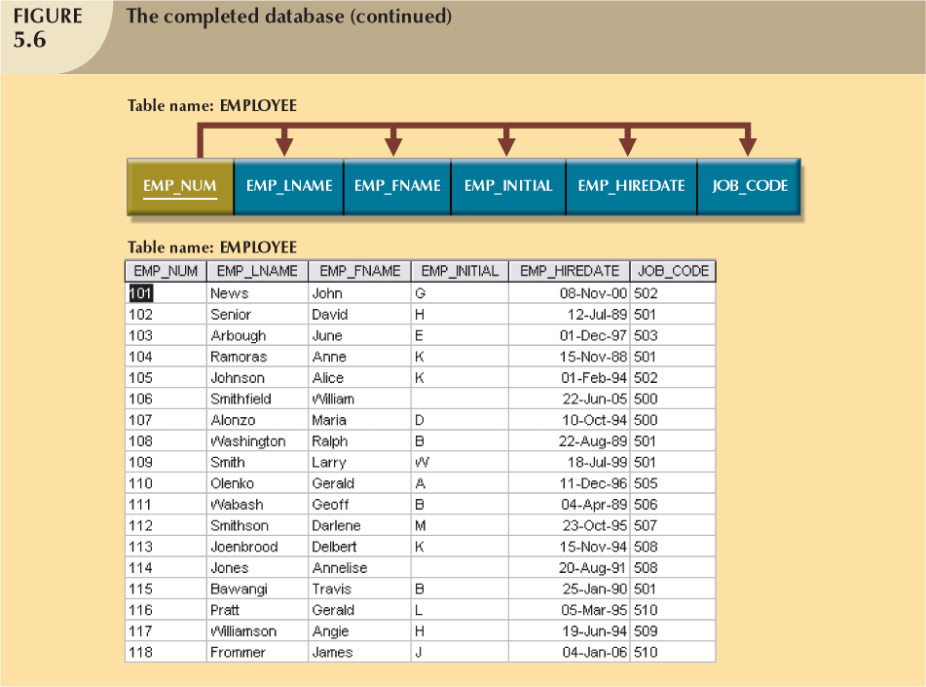
This is what the structure and contents of the Employee table should now look like.
Name Attribute has been broken up and other needed related attributes, such as Hire Date added

Slide 30
Surrogate Key Considerations
When primary key is considered to be unsuitable (read more on page 191-192), designers use surrogate keys such as numeric number which is automatically incremented.
Most databases systems provide mechanisms for implementing such numeric values (more on this in our SQL sessions)

Slide 31
Higher-Level Normal Forms
Tables in 3NF perform suitably in business transactional databases
(This is as far as we go in this course)
Higher order normal forms useful on occasion
Two special cases of 3NF:
Boyce-Codd normal form (BCNF)
Fourth normal form (4NF)
If you are interested, please refer to the text for further explanation and examples on these. No exam questions on BCNF or 4NF

Slide 32
Normalization and Database Design
Normalization should be part of the design process
Make sure that proposed entities meet required normal form before table structures are created
Many real-world databases have been improperly designed or burdened with anomalies
You may be asked to redesign and modify existing databases – so it is important that know how to use this tool.

Slide 33
Normalization and Database Design (continued)
The design process should use both ERDs and Normalization procedures.
You may need to further refine or add to your ERDs after completing the Normalization process.

Slide 34
Normalization and Database Design (continued)
Creation of normalized relations is important database design goal
Processing requirements should also be a goal
If tables decomposed to conform to normalization requirements:
Number of database tables expands

Slide 35
Normalization and Database Design (continued)
Defects of unnormalized tables:
Data updates are less efficient because tables are larger
Indexing is more cumbersome
No simple strategies for creating virtual tables known as views

Slide 36
Next Step
With our entities normalised and all our relationships defined we are ready to implementing our design in an RDBMS (Internal Model)
Entities -> Tables
Attributes -> Columns within Tables
Entity Integrity is are implemented by creating Indexes for Primary Keys which guarantee uniqueness and non null values
Referential Integrity is implemented by creating references between PKs and FKs. Once implemented the Internal Model guarantees no violations (PK existence for FK updates, non removal of PK rows where records(s) exist in child table)
Other constraints (including Non Nulls and default values)are registered at table creation/alter and are automatically guaranteed by the internal model.
Exam

Slide 37
Summary
Normalization is used to minimize data redundancies
First three normal forms (1NF, 2NF, and 3NF) are most commonly encountered
Table is in 1NF when:
All key attributes are defined
All remaining attributes are dependent on primary key

Slide 38
Summary (continued)
Table is in 2NF when it is in 1NF and contains no partial dependencies
Table is in 3NF when it is in 2NF and contains no transitive dependencies
Table that is not in 3NF may be split into new tables until all of the tables meet 3NF requirements
Normalization is important part—but only part—of the design process

Slide 39
Summary (continued)
Tables are sometimes denormalized to yield less I/O, which increases processing speed
Please read all of Chapter 6
A good technical read on Normal forms for those who are interested http://www.bkent.net/Doc/simple5.htm

Slide 40
Data Warehousing
This is covered in Chapter 13
You need to read this chapter in your own time (Student Home Study Module)
No Discussion questions questions on this topic
Any possible questions on this topic will be taken from the summary given on the chapter and is to be found on page 564. (just one page!)

Slide 41
Normalization – Class/Group Exercise
Let’s take a break.
Back at:
When we come back, work on the class group exercise.
Chapter 6 Problems: Question 3
Answers on separate slides – to come.

